Slide 1
Interim Presentation 1 Hand Gesture Recognition
Marko Zako
Arestis Konstantinou
EPL445 Group Project

Slide 2
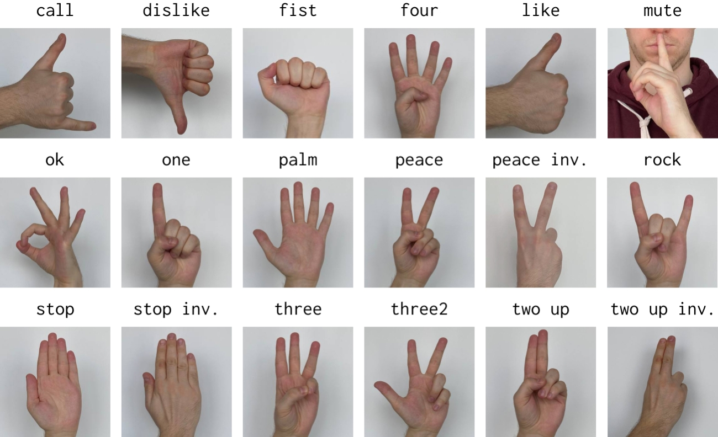
Introduction
Goal: Classify hand gestures given an input video (live webcam), trained on a hand gesture image database.
Motivation: Hand gesture recognition is a lightweight, non-invasive input method for HCI. Also very important for people with hearing disabilities.

Slide 3
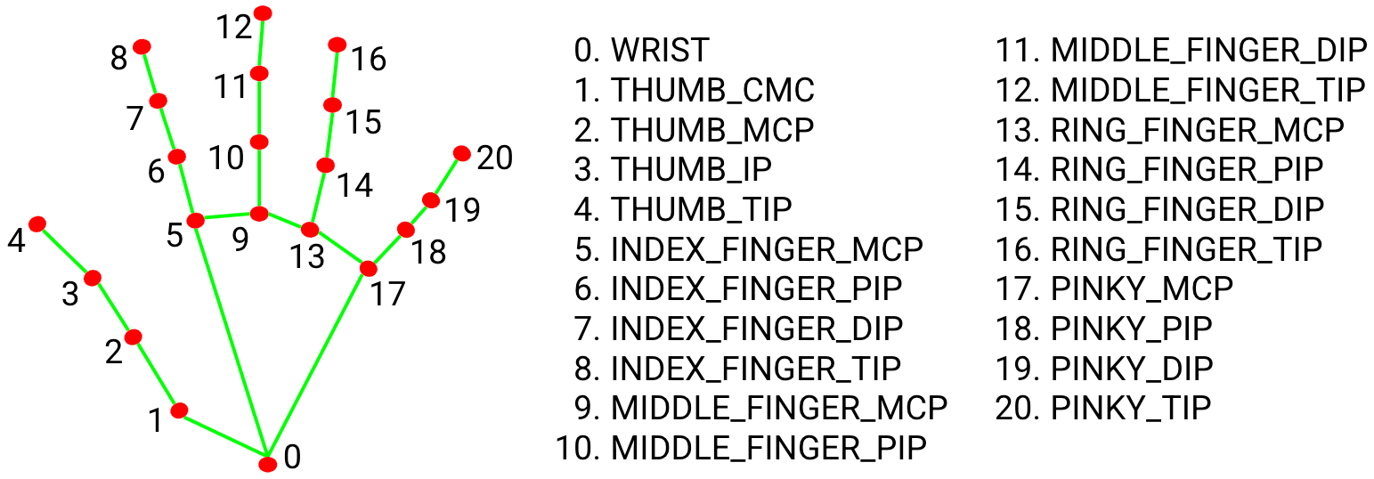
Methodology
Convert the input images to x,y coordinates (hand patterns), based on MediaPipe API hand patterns, which use CNN.
Take those coordinates (all labeled in different categories) and train our feed-forward neural network on hand patterns.
Take each frame of video input, crop out the hand found, pass that hand to a CNN to get the hand structure (MediaPipe API), give that to the trained neural network and test it. A result will be displayed in each frame.

Slide 4
Database
We will train our model based on the HaGRID (HAnd Gesture Recognition Image Dataset) database found on Kaggle:
https://www.kaggle.com/datasets/kapitanov/hagrid
Since this is a VERY large database (TB’s!), we will only use a subset of the images (120K images, 384p each).
The images are divided into 18 classes: call, dislike, fist, four, like, mute, ok, one, palm, peace, peace_inverted, rock, stop, stop_inverted, three, three2, two_up, two_up_inverted

Slide 5

Resources Available
Language: Python 3.12
Libraries: NumPy, CSV, OpenCV, MediaPipe, TensorFlow, scikit-learn
Database previously mentioned.
Some trained models on the internet, we will train our own model.

